Slide 1



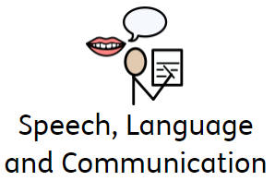
Language and Communication at Parayhouse School
Click here to find out more information about the CLPE Schemes we use to support our L&C curriculum
Click on the circles to find out more

Slide 2
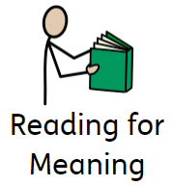
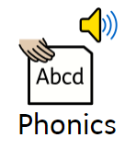

Click on Phonics to find out more
Click to go back to front page

Slide 3
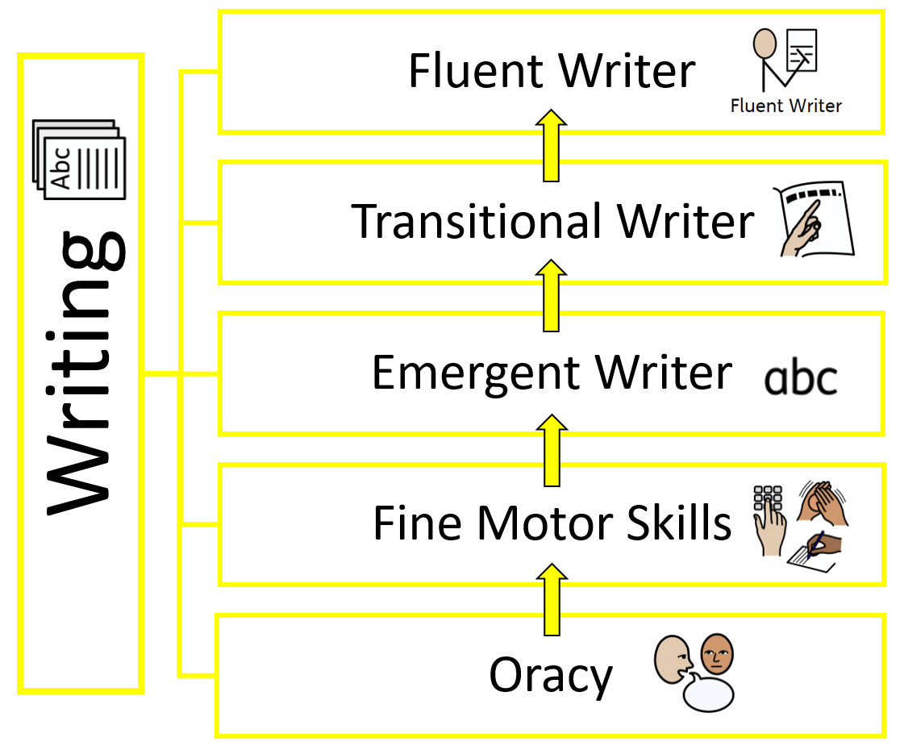
Progression of Skills for Writing
Click to go back to front page

Slide 4

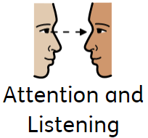
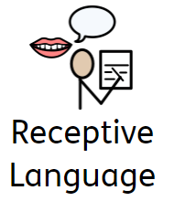
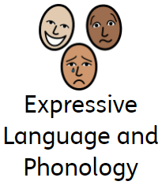
Click to go back to front page

Slide 5

Schemes used to support the progression of Phonics at Parayhouse School
Phonics
Fresh Start
Read Write Inc Phonics
Nursery Phonics
Hamilton Trust
Click here to find out more information about the Ruth Miskin Phonic Schemes
Click to go back to front page

