Slide 1
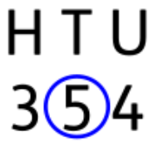
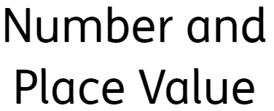
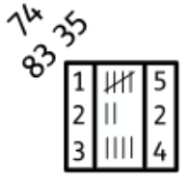

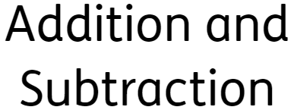
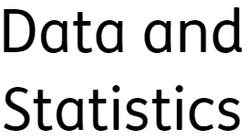
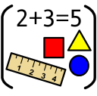

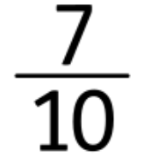

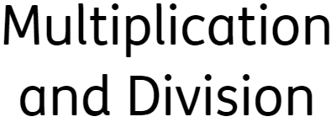



Maths
Formal Curriculum Pathway
Click on the circles to find out more

Slide 2
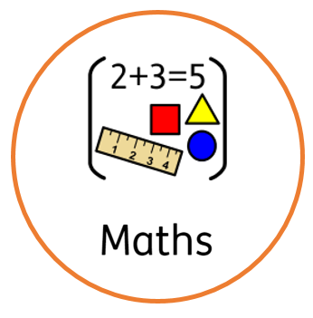
Learners within the formal curriculum pathway have discrete daily maths lessons. This follows a highly adapted national curriculum. Learning is scaffolded through a spiral curriculum approach revisiting key concepts and building on prior learning to consolidate knowledge.
Click to go back to front page

Slide 3
Chart to show progression of skills:
Number and Place Value
Apply knowledge of partitioning number to varied mathematical problems
Recognise place value of digits in 3 digit numbers
Compare and order numbers to 100
Click to go back to front page

Slide 4
Chart to show progression of skills:
Addition and Subtraction
Solving problems with multiple steps
Recording addition and subtraction in columns to support place value
Add and subtract one and two-digit numbers to 20
Click to go back to front page

Slide 5
Chart to show progression of skills:
Multiplication and Division
Writing and calculating mathematical statements for multiplication and division
To begin to use multiplication tables and recall multiplication facts
Making connections between arrays, number patterns and counting in twos, fives and tens
Click to go back to front page

Slide 6
Chart to show progression of skills:
Shape
Explore symmetrical and non-symmetrical
Handle, identify and describe properties of 2D and 3D shapes
Recognise, handle and name common 2D and 3D shapes in different sizes and orientations
Click to go back to front page

Slide 7
Chart to show progression of skills:
Fractions
Exploring decimal places
Doubling and halving numbers
Fraction of shapes ½, whole and ¼
Click to go back to front page

Slide 8
Chart to show progression of skills:
Data and Statistics
Interpret and present data using simple scales
Ask and answer simple questions around data presented
Interpret and construct simple pictograms, tally charts, block diagrams and simple tables
Click to go back to front page

