Slide 1






Click on the circles to find out more

Slide 2

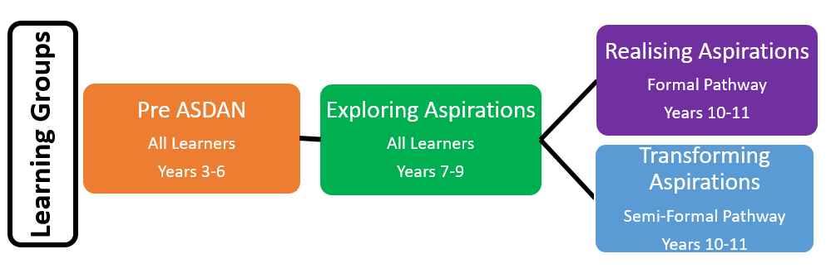
Pre-ASDAN - thematic approach based on the module topic for My Independence and prepares learners for developing the knowledge and understanding required for Exploring Aspirations at year 7
Click here to find out more information about the ASDAN ‘My Independence’ course
Transforming Aspirations – each pathway contains activities in 12 subject areas. Learning opportunities are fully cross curricular, embedding the 4 areas of Preparation for Adulthood.
Click to go back to front page

Slide 3
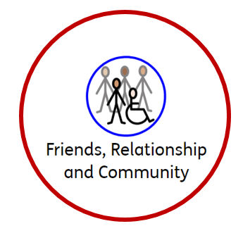
Being and active citizen
My friendships and relationships
My rights and responsibilities
Places I visit
Help and support
Community activities
The environment
Helping others
Travel and Transport
My friends and relationships
Realising Aspirations
Exploring Aspirations
Click to go back to front page

Slide 4

Getting about
My help and support
My independence
My choices
Jobs I do at my home or centre
Using kitchen appliances
Making a drink or a snack
Using technology
Dangers
Private places
Realising Aspirations
Exploring Aspirations
Click to go back to front page

Slide 5

My health services
My healthy lifestyle
Understanding my behaviour
My healthy activities
Healthy eating
Personal hygiene
My behavior
My health services
Harmful substances
My personal identity
Realising Aspirations
Exploring Aspirations
Click to go back to front page

Slide 6

Getting a job
My enterprise projects
My work experience
Jobs my family and friends do
Jobs in my community
Working indoors
Working outdoors
Equipment used at work
Visiting a workplace
Following rules
Realising Aspirations
Exploring Aspirations
Click to go back to front page

